Slide 1
Antenna Design Machine Learning Model
Mohd. Danish Khursheed
Dpt. Of Electronics Engineering
Zakir Hussain College Of Engineering and Technology, AMU

Slide 2
Contents:
Requirements
Model Explanations
Model Architecture
Conclusion

Slide 3




Requirements:
TensorFlow
Keras
Pandas
NumPy
Matplotlib
Scikit-learn
Git (optional)

Slide 4
Model Explanation:
Dataset: The dataset is open sourced on www.Kaggle.com. It contains 13 columns and 573 rows. Each column represents a different parameter of antenna design, for e.g.; width and height of the SRR cell, gap between the ring, distance between antenna patch and array, antenna gain, width of the rings etc.
Data Pre-processing: All the parameter are scaled by the method of robust scaling , except the target variables.
Approach: Our aim is to make a model which can learn upon the said parameters and be able to make valid predictions of the target variable on an arbitrary dataset. By target variable we meant those variable that model would be able to predict upon seeing the other required parameters. We would take two parameters as target variable namely :
Power Radiated
Power Accepted

Slide 5
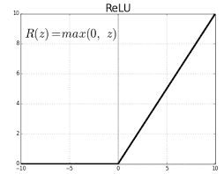
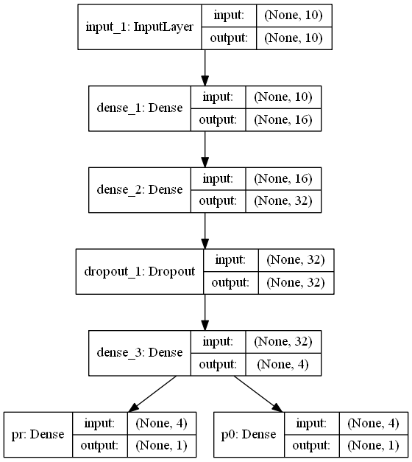
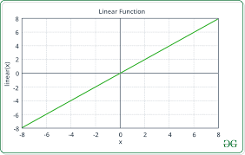
Model Architecture:
Layers:
Dense -- (5) – Activation function = ReLU
– Activation function (output layer) = Linear
Dropout -- (1)
Loss Function:
Mean Squared Error (for both the output layers)
Metrics:
Mean Absolute Error (for both the output layer)
Optimizer:
Adam (with default values)

Slide 6
Conclusion:
In this exemplar deep learning model we predicted two significant parameters for antenna designing. This could also be done on a much larger and a more professional scale which would result in the significant efficiency boost in designing process.
Generally data is much more thoroughly pre-processed and also is much more in amount, which in return result in better results.
Model Code File Link: https://github.com/thatdanish/IEEE-AP-MTT-Report-Project/blob/master/antenna_design.ipynb

